Slide 1

Basic Details of the Team and Problem Statement
Organization Name: Ministry of Environment
PS Code: SIH1393
Problem Statement Title: Water and Electricity Tracking App
Team Name: Watroelectic
Team Leader Name : Nilesh Prasad Dubey
Institute Code (AISHE):C-16656
institute Name: RSR rungta colleges of engineering and technology in bhilai chhatisgarh
Theme Name: Smart Automation

Slide 2
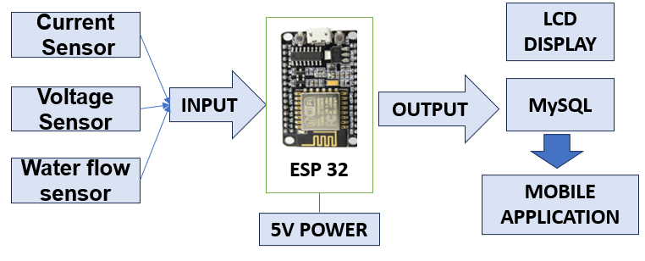
Idea/Approach Details
Describe your idea/Solution/Prototype here:
With our new mobile application designed to empower you in the pursuit of your sustainable lifestyle.
Our app goes beyond traditional application management; It`s your personal guide to reaching your hydropower consumption goals.
With this app, you not only track your consumption but also embark on a journey of conscious and responsible consumption, which will have a positive impact on your wallet and environment we are surrounded by it.
Describe your Technology stack here:
React Native(for Application)
Php(for Api)
Mysql(for Database)
Arduino IDE(for hardware)
ESP 32
Current sensor
Voltage sensor
Flow sensor

Slide 3
Idea/Approach Details
Describe your Use Cases here
Describe your Dependencies / Show stopper here
Amperes and voltage monitoring for optimizing energy efficiently.
Informs you about your power consumption .
Water consumption status. It involves monitoring the volume or flow rate of water in real-time to understand usage patterns, identify potential leaks or inefficiencies, and promote water conservation efforts.
Bill payment gateway ensures a hassle-free experience for consumers, making it quick and efficient to manage their electricity payments, ultimately enhancing customer satisfaction and encouraging on-time bill settlements.
Earning reward points in the app for consuming less electricity is a gamified incentive system. Users receive points or rewards when they reduce their electricity consumption compared to previous periods.
Internet Connection is Required
Need Server to store data.
Keep the device away from moist places.
Working Properly on certainoperating system.

Slide 4
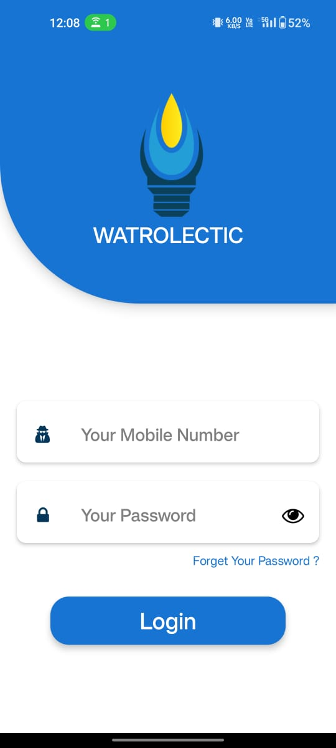
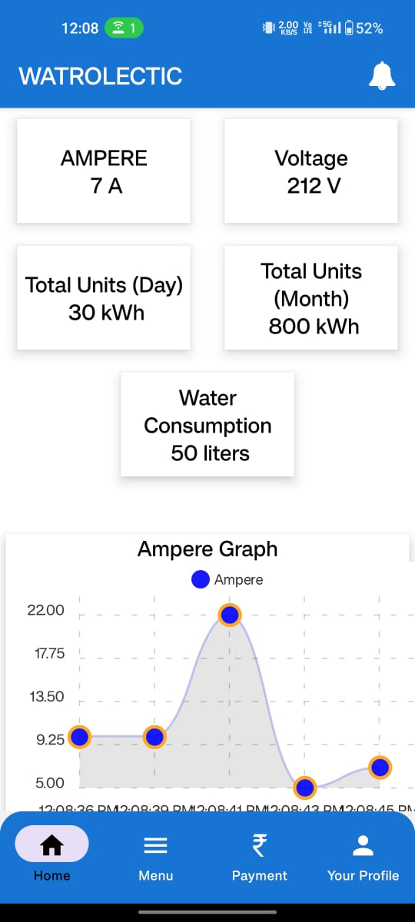
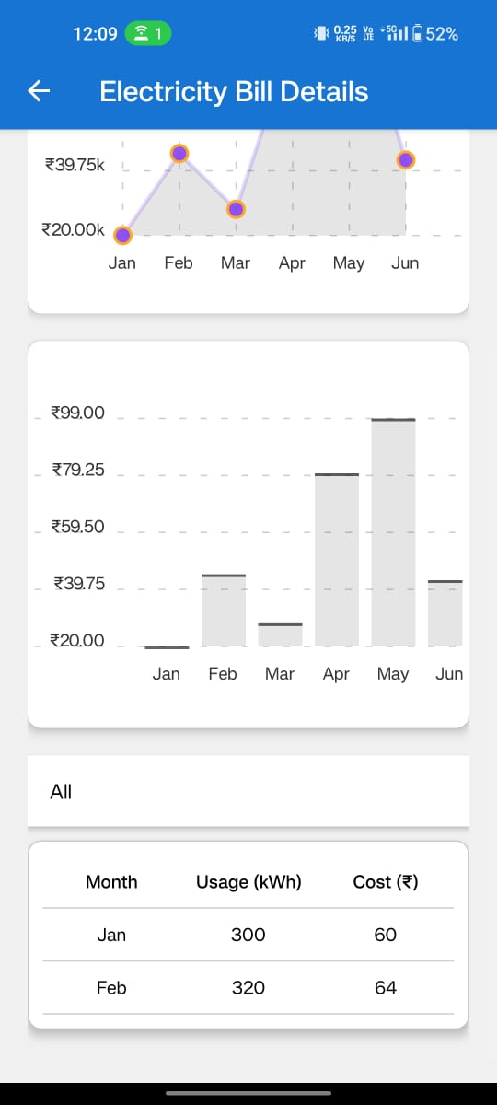
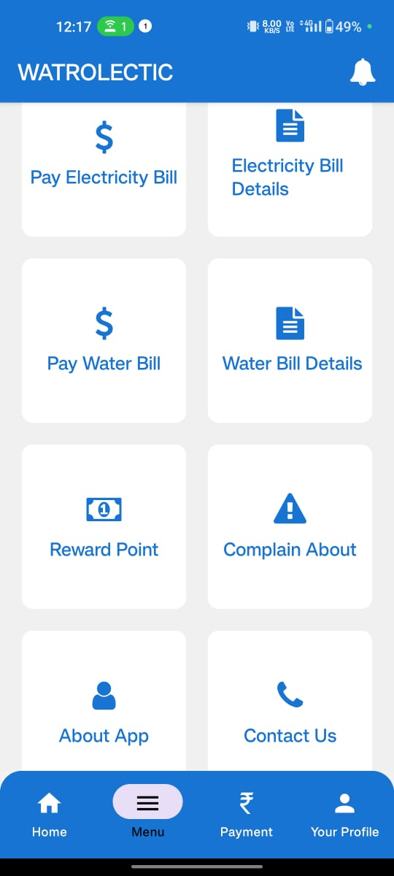
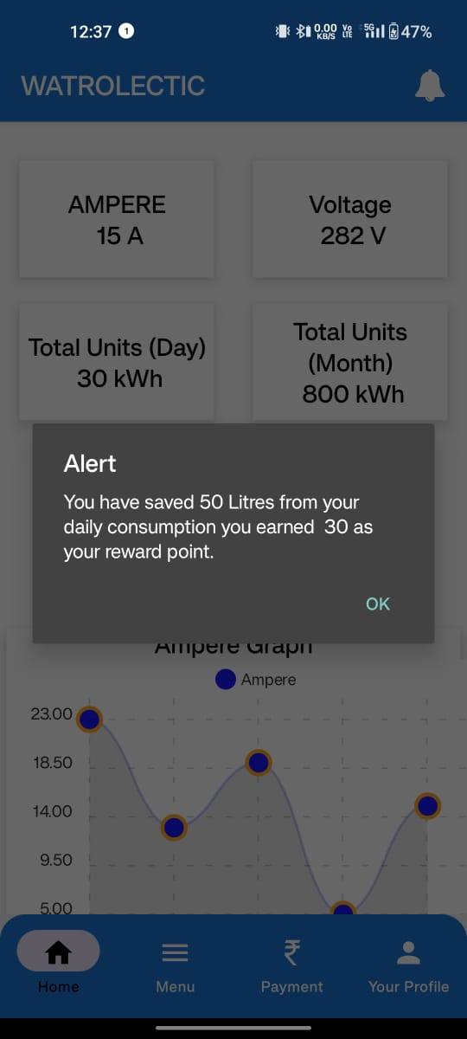
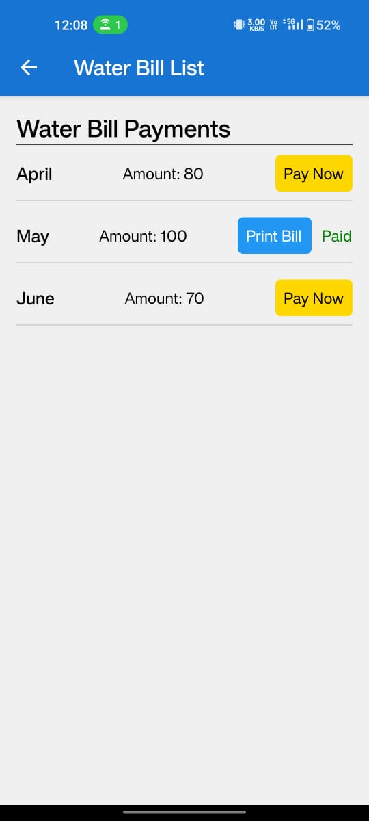
Screenshot Of Our Running Modal
LOGIN
DESHBOARD
GRAPH & DATA
MENU
ALERTS
BILL PAYMENTS

Slide 5
Team Member Details
Team Leader Name: Nilesh Prasad Dubey
Branch (Btech) Stream ( CSE) Year (IV)
Team Member 1 Name: Vivek chandrakar
Branch (Btech) Stream (CSE) Year (III)
Team Member 2 Name: Anjilina Dambale
Branch (Mca) Stream (CSE) Year (II)
Team Member 3 Name : Kamya Rai
Branch (Btech) Stream (aiml) Year (III)
Team Member 4 Name: Dharna Gangboir
Branch (Btech) Stream (EE) Year (III)
Team Member 5 Name: Deepanshu Sinha
Branch (Btech) Stream (CSE) Year (III)
Team Mentor 1 Name: Mr. Sachin Harne
Category (Industry) Expertise (Blockchain,Networking,IOT,Cyber Security,Image Processing) Domain Experience (14 years)
Team Mentor 2 Name: Rupali chandrakar
Category (Academic): Expertise (Image Processing,Computer Networking ): Domain Experience (5 years)

